Slide 1
Unveiling Minot's Wildfire Smoke Impact: Data & Ethical Insights
Empowering Policy Through Analytical & Ethical Perspectives
AKSHIT MIGLANI

Slide 2
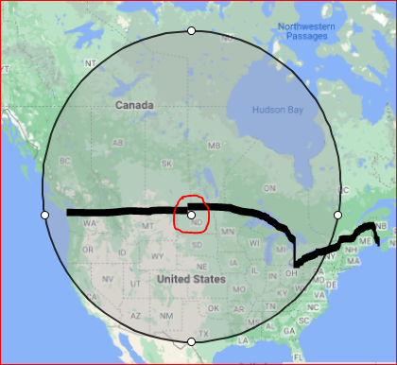
LOCATION CONSIDERATION
The location assigned to me is Minot, North Dakota. The state's landscape, with its mix of grasslands, forests, and agriculture, is susceptible to fires, especially during dry and hot periods. As highlighted in black, it’s close to the border of US-CANADA

Slide 3
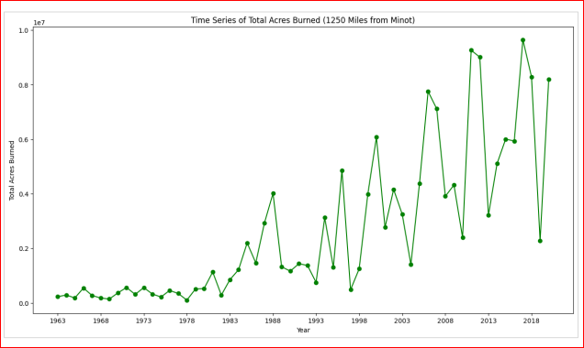
TOTAL ACRES BURNED
The smoke from these fires can have far-reaching effects, causing respiratory problems, reducing visibility on roads, and affecting overall air quality. In recent years, with the increase in wildfires globally due to climate change, there's been heightened awareness of the impact of wildfire smoke in North Dakota.

Slide 4
IMPACT
Health Impact
Economic Impact
AQI Impact
Wildfire smoke contains particulate matter and other pollutants that can lead to respiratory issues. Increased instances of asthma, bronchitis, and other respiratory problems can occur during periods of intense wildfire activity.
Wildfires have economic consequences, including firefighting costs, damage to property and infrastructure, healthcare expenses due to smoke-related illnesses, and impacts on agriculture and tourism industries.
Wildfire smoke significantly impacts the AQI. When smoke drifts from neighboring states or provinces, the AQI in North Dakota can reach unhealthy or hazardous levels, affecting respiratory health and visibility.

Slide 5
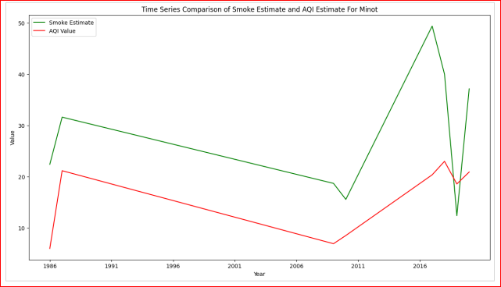
COMPARISON OF SMOKE AND AQI ESTIMATE
There is a temporal interplay between the smoke estimate, derived from an ARIMA model within a 1250-mile radius of Minot and the government provided AQI. The correlation coefficient of 0.65 suggests a moderately positive link between the two variables, indicating a discernible alignment in their trends

Slide 6
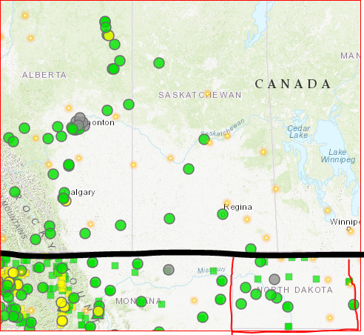
Ethical Implications: Responsible Interpretation
There is a temporal interplay between the smoke estimate, derived from an ARIMA model within a 1250-mile radius of Minot and the government provided AQI. The correlation coefficient of 0.65 suggests a moderately positive link between the two variables, indicating a discernible alignment in their trends

Slide 7
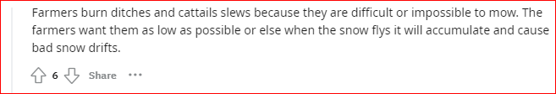
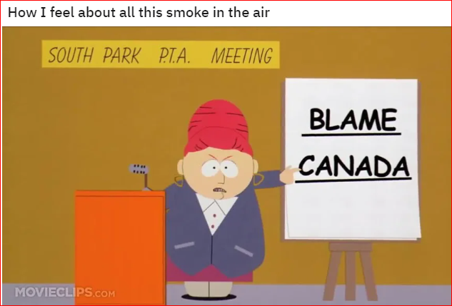

Policy Guidance: Community Experience/Response

Slide 8
Community Health Protection Policies: smoke exposure monitoring system that provides real-time data and alerts to residents
Equity-Centric Initiatives: Provide free respiratory protection equipment to low-income households, ensuring equitable access to safety measures
Long-term Resilience Strategies: Invest in green infrastructure and urban planning, integrating fire-resistant building materials or creating defensible spaces.
Community
Awareness
Health & Equity
Research
Resilience
Public Awareness Campaigns: Engage in community outreach programs & public education campaigns to ensure that residents are well-informed about smoke-related health risks and empower them to take protective actions.
Research and Data Collaboration: Illustrate how ethical considerations, such as community engagement and informed consent, will be integrated into data collection processes to respect residents' rights and perspectives

Slide 9
Community Health Protection Policies: smoke exposure monitoring system that provides real-time data and alerts to residents
Equity-Centric Initiatives: Provide free respiratory protection equipment to low-income households, ensuring equitable access to safety measures
Long-term Resilience Strategies: Invest in green infrastructure and urban planning, integrating fire-resistant building materials or creating defensible spaces.
Community
Awareness
Health & Equity
Research
Resilience
Public Awareness Campaigns: Engage in community outreach programs & public education campaigns to ensure that residents are well-informed about smoke-related health risks and empower them to take protective actions.
Research and Data Collaboration: Illustrate how ethical considerations, such as community engagement and informed consent, will be integrated into data collection processes to respect residents' rights and perspectives

Slide 10
Extension Plan
Classify Fires:
Prairie Fires: fires were often ignited by lightning strikes and helped maintain the health of the ecosystem by clearing dead vegetation and allowing new growth
Fires originating outside North Dakota within 1250 miles
Fires originating within North Dakota within 1250 miles
Unclassified/Others
How does fire smoke relate to the chronic respiratory disease rate in Ward County, Minot across different years?

Slide 11
Impact
Understanding these ethical impacts and enlightening policymakers and residents about potential future scenarios arising from smoke exposure in their community is critical. Forecasting and classifying the potential trends in hospitalizations or fatalities in upcoming years can aid in devising strategies to mitigate these effects.
Prepare & Act

